Slide 1
借力的力量 POWER OF LEVERAGE 你想迅速每週賺取HK$11,500嗎？或你想更快賺取HK$2,300支票嗎？ Do you want to make HK$11,500/week FAST? Or Do you want to make HK$2,300 check FASTER?

Slide 2
Strategic numbers 策略目標數字
每月自用100 – 150 BV
“潛在人選名單” 60 – 300個名字
首12個月，每月銷售100(新生意)
每月向四位合格人選展示計劃
100 – 150 BV/Month Personal Use
60 – 300 Names for “Possibility List”
Sell 100 BV (New Business) per month first 12 month in business
Show Plan to 4 qualified individuals per month

Slide 3
檢視並將潛在人選分組，以建立團隊 Reviewing and Grouping Possibilities to Build Teams
B
X
X
B
X
X
X
B
X
B
你YOU
B
X
A
B
X
B
X
B
X
X
A
A
A
X
B
X
A
B
B
X
A
B
X
A
A
X
A
A
A
A
A
X =潛在人選Your Possibilities
A =朋友/家人Friends/Family
B =工作Work
A
A

Slide 4
檢視並將潛在人選分組，以建立團隊 Reviewing and grouping possibilities to build teams
名字NAME (XBA)
名字NAME (XBA)
名字NAME (XBA)
名字NAME (XA)
名字NAME (XA)
名字NAME (XA)
名字NAME (XA)
名字NAME (X)
名字NAME (X)
名字NAME (X)
60 – 300 或以上plus
主要分組 Key Groupings:
X =潛在人選Your Possibilities
A =朋友/家人Friends/Family
B =工作Work

Slide 5
建立團隊和放置策略 Team building and placement strategy
你YOU
註 Key :
X =潛在人選Your Possibilities
A =朋友/家人Friends/Family
B =工作Work
XA
X
XA
X
XB
X
XB
X
XA
在他們分組名單的每個分類中，維護最大的經濟利益
Maintain vested economic interest in the success of each within the grouping they originated from on your Possibilities List
XB
XA

Slide 6
訂立團隊行動計劃的假設 Assumptions for creating a Team Plan of action
銷售美安香港產品賺取30%零售利潤
零售HK$750美安香港產品 = HK$225或以上利潤
零售HK$750美安香港產品 = 50 BV或更多
每月零售HK$1,500 = 100BV
每月零售HK$1,500 = HK$450利潤
30% retail profit on sale of MHK Branded Products
HK$750 retail sales of MHK Branded Products = HK$225 profit
HK$750 retail sales of MHK Branded Products = 50 BV
HK$1,500 retail Sales/month = 100BV
HK$1,500 retail Sales/month = HK$450 profit

Slide 7
訂立團隊行動計劃的假設 Assumptions for creating a team Plan of action
50%或以上顧客會每月重複購物（化妝品、護膚品及健康與營養產品的額外銷售）
HK$1,500零售 (新產品) x 12個月= HK$18,000 (新產品)/月
HK$18,000 (新產品) x 50% = HK$9,000 (重複購物)/月
HK$9,000 (重複購物)月= 600 BV (重複購物)/月
HK$9,000 (重複購物)月= HK$1,350重複利潤
兩(2)個超連鎖店主團隊，各產生5,000 BV，帶來HK$11,500佣金
50% or more clients will be repeat buyers monthly (based on add-on sales of cosmetics, skincare and health and nutrition supplements, etc..)
HK$1,500 retail Sales (New Business) x 12 months = HK$18,000 (New Business)/month
HK$18,000 (New Business) x 50% = HK$9,000 (Repeat Business)/month
HK$9,000 (Repeat Business) month = 600 BV (Repeat Business)/month
HK$9,000 (Repeat Business) month = HK$1,350 Repeat Profit Two (2) teams of UnFranchise® Owners each generating 5,000 BV results in $11,500 in commissions

Slide 8
訂立團隊行動計劃的假設 ASSUMPTIONS FOR CREATING THE TEAM’S PLAN OF ACTION
每個超連鎖店主(團隊成員)承諾每月使月100-150BV產品
每個超連鎖店主(團隊成員)承諾每月零售HK$1,500 = 每月HK$450零售利潤及100 B 開展事業的頭12個月
每個超連鎖店主(團隊成員)承諾每月向四(4)個合格潛在夥伴展示計劃
註冊比例8:1
向8個合格潛在夥伴展示計劃
註冊一(1)個超連鎖店主
Each UnFrachise™ Owner (Team Member) commits to use 100 – 150 BV / month
Each UnFranchise™ Owner (Team Member) commits to selling HK$1,500 at retail / month = HK$450 retail profit and 100 BV/month FIRST 12 MONTHS IN BUSINESS
Each UnFranchise™ Owner (Team Member) commits to exposing the Business Plan to four (4) qualified individuals per month
Registration ratio of 8:1
Expose Business Plan to eight qualified individuals
Register one (1) new UnFranchise™ Owner

Slide 9
訂立團隊行動計劃的假設 ASSUMPTIONS FOR CREATING THE TEAM’S PLAN OF ACTION
左
按8:1比例計算的團隊成長
第1個月 = 你 + 1 (8個合格潛在夥伴)
第2個月 = 你 + 2 (12個合格潛在夥伴)
第3個月 = 你 + 3 (16個合格潛在夥伴)
第4個月 = 你 + 5 (20個合格潛在夥伴)
第5個月 = 你 + 1 (8個合格潛在夥伴)
第6個月= 你+ 2 (12個合格潛在夥伴)
第7個月= 你+ 3 (16個合格潛在夥伴)
第8個月 = 你 + 5 (20個合格潛在夥伴)
Team Growth Based on 8:1 Ratio
Month 1 = You + 1 (8 qualified individuals)
Month 2 = You + 2 (12 qualified individuals)
Month 3 = You + 3 (16 qualified individuals)
Month 4 = You + 5 (20 qualified individuals)
Month 5 = You + 1 (8 qualified individuals)
Month 6 = You + 2 (12 qualified individuals)
Month 7 = You + 3 (16 qualified individuals)
Month 8 = You + 5 (20 qualified individuals)
L
E
F
T
RI
GHT
右

Slide 10
訂立團隊行動計劃的假設
ASSUMPTIONS FOR CREATING THE TEAM’S PLAN OF ACTION
按8:1比例計算的團隊成長
Team growth based on 8:1 ratio
你YOU
第1個月Month 1
第一個月Month 1
第5個月Month 5
第2個月Month 2
第6個月Month 6
第3個月Month 3
第7個月Month 7
第4個月Month 4
第8個月Month 8
第4個月Month 4
第8個月Month 8

Slide 11
你YOU
第1個月Mth 1
第1個月Mth 1
第5個月Mth 5
第2個月Mth 2
第6個月Mth 6
第3個月Mth 3
第8個月Mth 7
每位超連鎖店主=
• 起初300 – 600 BV • 每月自用100 – 150 BV •每月100 – 600 BV
Each UFO=
• 300 – 600 BV Initial • 100 – 150 BV/Month Personal Use • 100 – 600 BV/Month
第4個月Mth 4
第8個月Mth 8
第4個月Mth 4
第8個月Mth 8
第5個月Mth 5
第9個月Mth 9
第5個月Mth 5
第9個月Mth 9
第6個月Mth 6
第9個月Mth 9
第6個月Mth 6
第10個月Mth 10
第6個月Mth 6
第10個月Mth 10
第10個月Mth 10
第10個月Mth 10

Slide 12
達成目標 Achieve your goals
單靠你自己的努力和成果
By solely relying on your efforts and results
或OR
建立兩(2)個超連鎖店主團隊
By building two (2) teams of UnFranchise™ Owners

Slide 13
按播放就是了！ JUST PUSH PLAY!

Slide 14
強效物色 Power Prospecting
目標：建立兩個銷售及分銷組織，每個每週產生5,000 BV以上！
相等於：右邊組織50個經銷每人產生每 月 ≥ 400 BV (每月20,000 BV)及右邊組織50個經銷商每人產生每月 ≥ 400 BV (每月20,000 BV)
Objective: Build two sales and distribution organizations each generating in excess of 5,000 BV every week!
Equivalent to: 50 Distributors in Right Organization generating ≥ 400 BV/Month each (20,000 BV/Month) and 50 Distributors in Right Organization generating ≥ 400 BV/Month each (20,000 BV/Month)

Slide 15
強效物色 Power Prospecting
思想上的方法/條件
重質不重量
要先得到足夠的數量，才可獲得質量
你需從大量的物色數量中才得到質量
你在尋找一些正在找尋機會的人
Mental Approach / Conditioning
Quality NOT Quantity
It takes Quantity TO GET Quality
You GET Quality by PROSPECTING Quantity
You are looking for individuals who are LOOKING…

Slide 16
強效物色 Power Prospecting
思想上的方法/ 條件 (續)
不要從自己角度評估… 直接跳到招募…
你不可以對對的人說錯的話
我們想要一些想做的人，做他們需要做的事，和取得他們想要的東西!!
24-36 個月的事業計劃 (不是 24-36天)
Mental Approach / Conditioning (cont’d)
DO NOT Pre-Qualify… Leads to RECRUITING…
You CAN NOT say WRONG thing to the RIGHT individual…
We WANT people that WANT TO DO, what THEY NEED TO DO, to GET WHAT THEY WANT!!
24-36 Month Business Plan (NOT 24-36 Day)

Slide 17
強效物色 Power Prospecting
正確物色: 你只需要複製”起步指南”… 一次! … 就可以賺取6位數字的年薪!
每月你產生 100 BV或以上 (自用)
每月你產生 300 BV或以上(重複零售)
每月你向8位朋友展示計劃
每月你推薦1位新經銷商
每年你跟8位經銷商重覆以上
Proper Perspective: You ONLY have to DUPLICATE the “Getting Started Guide”… ONE TIME! … TO EARN A SIX FIGURE ANNUAL INCOME!
You create ≥ 100 BV/Month (Personal Use)
You create ≥ 300 BV/Month (Repeat SALES)
You show the plan to 8 Prospects / Month
You sponsor 1 new Distributor/ Month
You DUPLICATE all the above with eight Distributors / Year

Slide 18
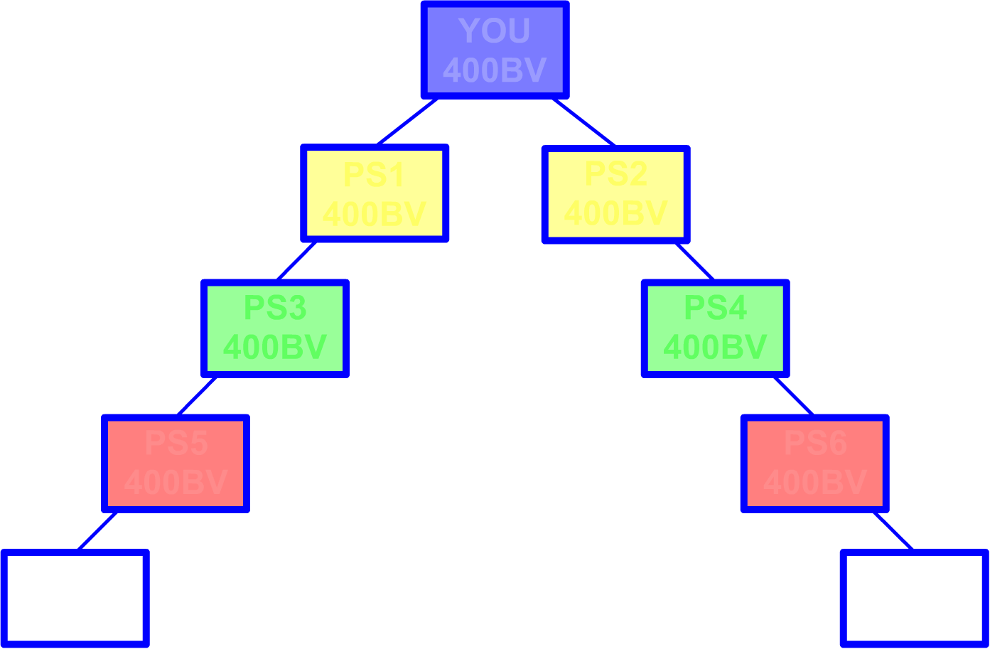

Slide 19
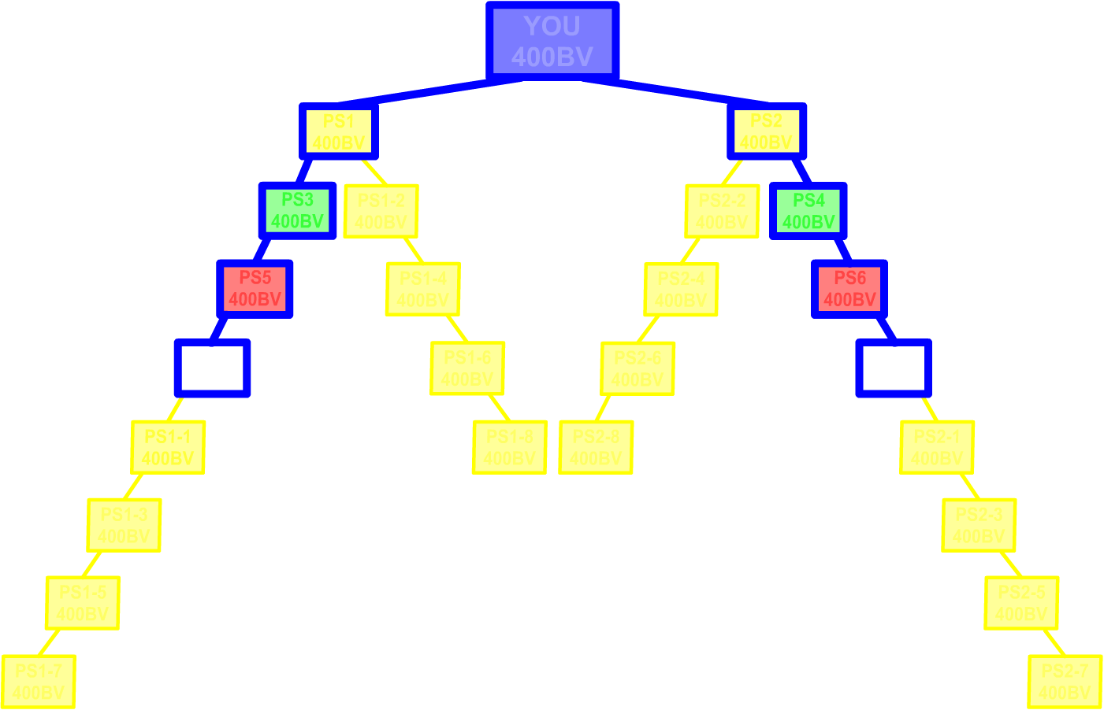

Slide 20
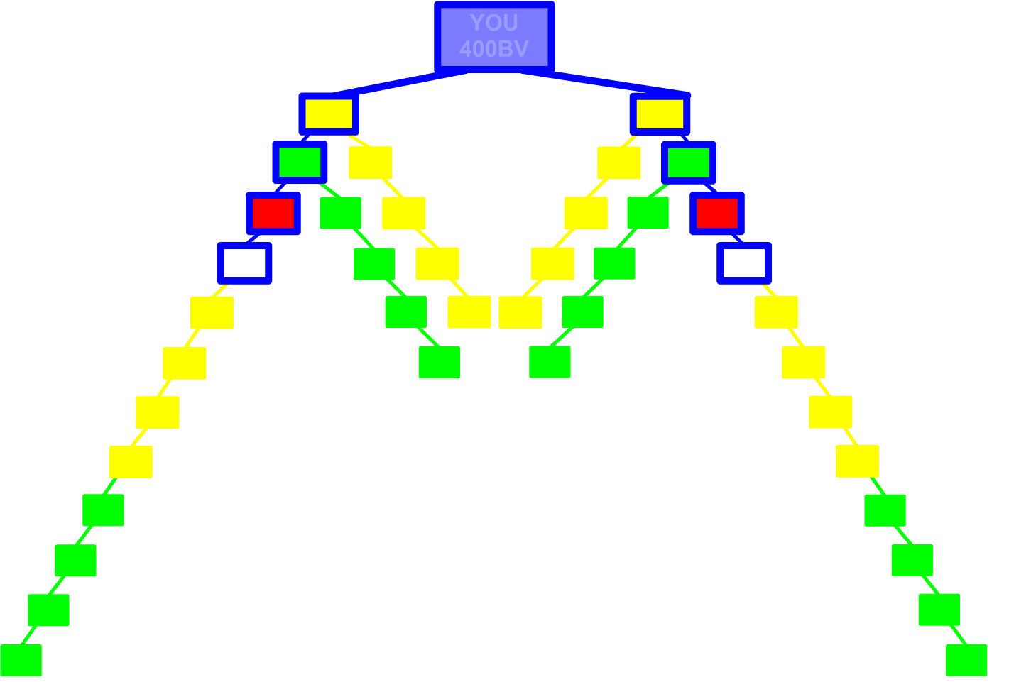

Slide 21
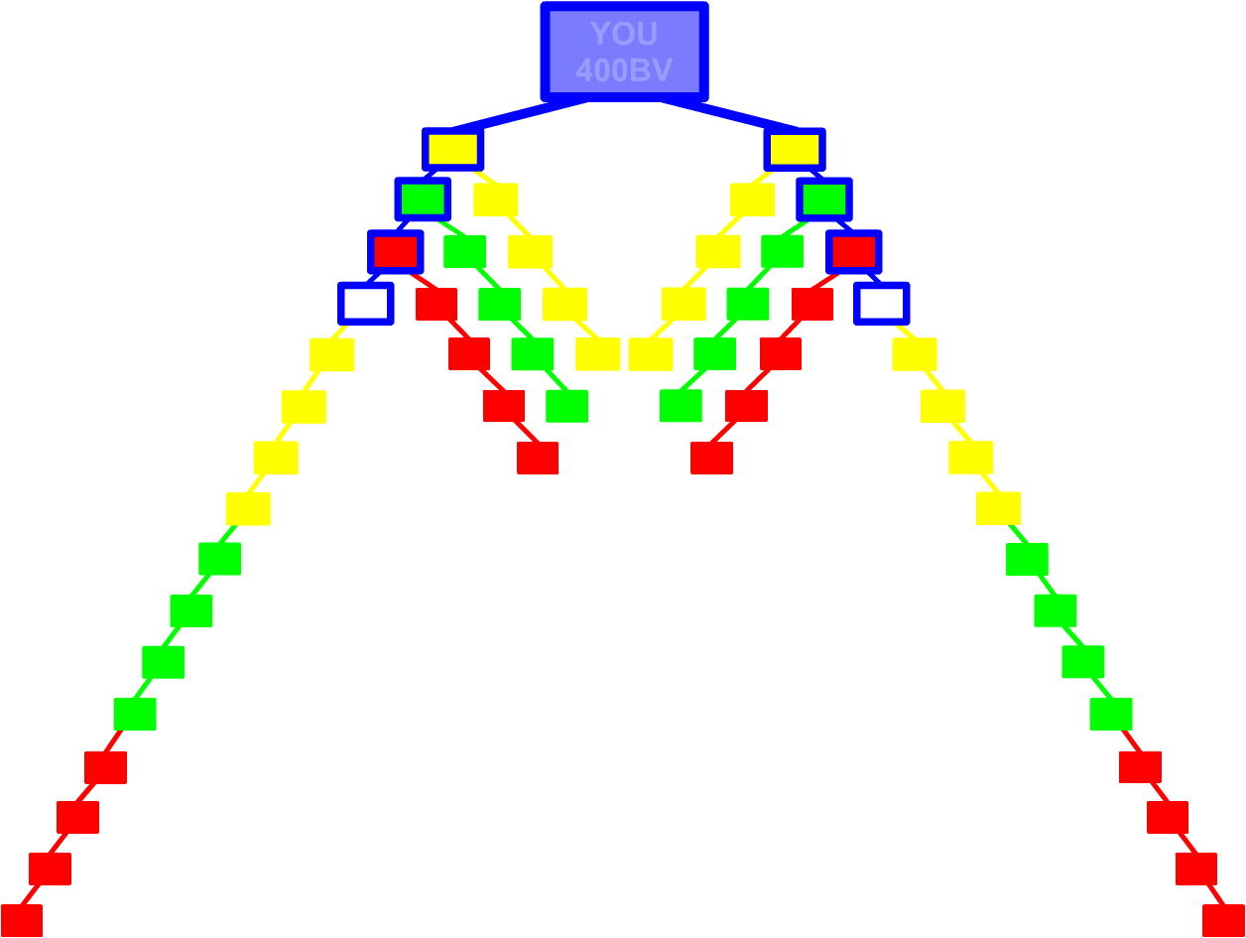

Slide 22
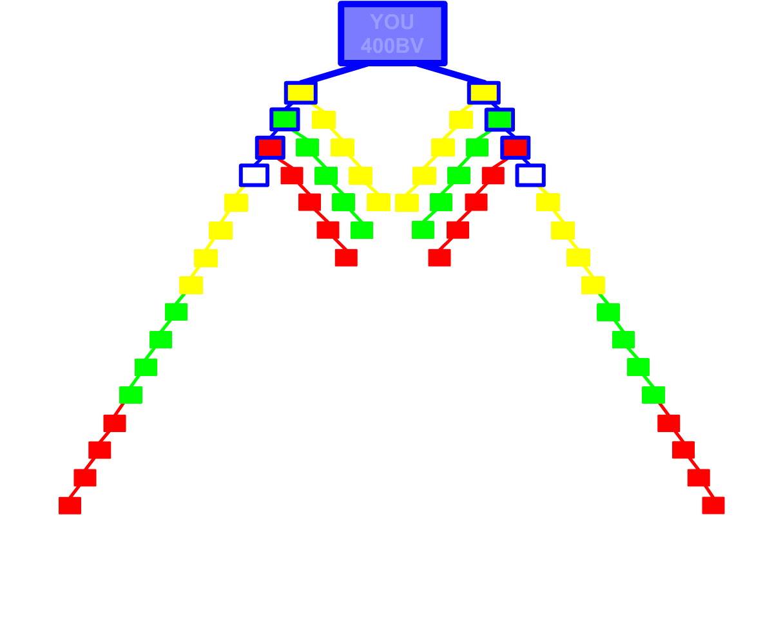

Slide 23
願景! 2-3年 vs. 45年計劃 PERSPECTIVE! 2-3 YEARS vs. 45 YEAR PLAN
25 -36個月 @ 每星期最少HK$11,500
每年持續性收入HK$598,000 – HK$1,435,000
25 -36 months @ HK$11,500/week minimum
HK$598,000 – HK$1,435,000 of Yearly Ongoing Income
12個月 Months HK$11,500
6個月Months HK$11,500
3個月Months HK$11,500
2個月Months HK$11,500
1個月Month HK$11,500
2星期Weeks HK$11,500
1星期Weeks HK$11,500
24個月 Months = HK$80,500

Slide 24
強效物色 Power Prospecting
挑戰: 我們怎麼令團隊裡所有夥伴立即行動，令其團隊成長?
… 和你的團隊成長?
The Challenge: How do we get ALL of the Distributors in our organization to immediately begin contributing to THEIR organizational growth?
… AND your organizational growth?

Slide 25
強效物色 Power Prospecting
面對兩端的困難:
太少
沒有名單… “可能影響關係”
沒有方法… “怎麼開始這主題?”
對於 “這是甚麼” 未有準備答案
預先審批資格… “只有某某才適合”
沒有信心… “不想失敗”
不能或不會展示計劃
Two Ends of the “Spectrum”:
Too Little
No Possibility List…
“Might ruin relationships”
No Approach…
“How do I bring it up?”
No Answer to “What Is It?”
Pre-Qualify… “Only ones that might be”
No Confidence… “Don’t want to blow it”
Can’t or Won’t Show the Business

Slide 26
強效物色 Power Prospecting
面對兩端的困難: (續):
太多
預先審批資格… 未有技巧
招募/說服… vs. 物色
講太多… 嚇怕他人
太在意結果
講太多資訊
太注重佣金收入…
Two Ends of the “Spectrum” (cont’d):
Too Much
Pre-Qualify… Don’t have skills
Recruit/Convince… vs. Prospect
Throw up… scare people
Focused too much on End Result
Overwhelm with too much information
“Commission Breath”…

Slide 27
強效物色 Power Prospecting
我們怎樣消除太多和太少?
How do we eliminate TOO MUCH and TOO LITTLE?

Slide 28
強效物色 Power Prospecting
1個方法: 當太少或太多，結果很少甚至沒有結果…
95% 的經銷商利用超連鎖事業簡報會作為介紹此生意給潛在朋友的第一個工具，他們只是依賴其他人做到招募!
ONE SOLUTION: When “TOO LITTLE” or “TOO MUCH” results in minimal to no RESULTS…
95% of Distributors use the UBP as a First Look and solely rely on someone else to make it happen!

Slide 29
強效物色 Power Prospecting
第二個方法: 為所有經銷商提供一個已證實可行的方法去專注物色… 而不是招募!!
這是一個所有人都能夠做到的方法，只怕你不做!
已把太少和太多消除
賦予任何人都能夠有效地參與他們組織的成長
為他人提供一個合理的期望!
Another SOLUTION: Provide ALL Distributors with a PROVEN PROCESS that focuses on PROSPECTING… NOT RECRUITING!!
A process that ANYBODY… ANYBODY can perform, IF they CHOOSE TO!
It takes “TOO LITTLE” and “TOO MUCH” out of the equation!
It empowers anyone with the ability to PRODUCTIVELY participate in the organizational growth of their organization
It becomes a REASONABLE EXPECTATION!

Slide 30
強效物色 Power Prospecting
展開並持續對話… 然後聆聽！！！
你做甚麼的？
我幫助想改善現有/未來財務狀況的人，方法是透過助他們建立可兼職經營的事業(每週10-15小時)，產生可觀而永續的額外收入。
Initiate and Sustain Conversation… then Listen!!!
What Do You Do?
I help people interested in improving their current/future financial position by establishing a business they can operate part-time (10-15 hours/wk) and generating a significant ongoing secondary source of income.

Slide 31
強效物色 Power Prospecting
展開並持續對話… 然後聆聽！！！
甚麼來的？
我與美安公司合作，這間公司提供“超連鎖事業發展系統”
這個系統根據任何人都可實際執行的原則建立
這是QVC與Amazon.com的混合體，但卻具有強效而卓越優勢… 入門網站、商機，還有人才動力
Initiate and Sustain Conversation… then Listen!!!
What Is It?
I use a company called Market America that provides what is called the “UnFranchise Business Development System.”
It is a system that was developed based on what any individual can realistically implement.
It is a true hybrid of QVC and Amazon.com, but with powerful and distinct advantages… A Web Portal, an opportunity, AND the power of people.

Slide 32
強效物色 Power Prospecting
展開並持續對話… 然後聆聽！！！
甚麼來的？
這間公司為超連鎖店主提供種類眾多的優質、市場主導產品與服務，讓超連鎖店主利用結合連鎖事業的好處、互聯網的便捷和一對一行銷的力量的系統銷售這些產品與服務。
超過15年來，這個系統獲數以萬計的人利用以改善財務狀況。
Initiate and Sustain Conversation… then Listen!!!
What Is It?
The company provides a wide variety of high quality, market driven products and services to Independent UnFranchise Owners who market them using a system that combines the strengths of franchising, efficiency of the Internet, and the power of One-to-One Marketing.
This system has been used by thousands of people to improve their financial situation for over 15 years.

Slide 33
強效物色 Power Prospecting
展開並持續對話… 然後聆聽！！！
建立關係和信任… 聆聽！
發問以了解他們…
識別渴望、需要、渴求… 發掘他們的為甚麼？
你認識想改善財務狀況並可能願意付出額外努力達成這個目標的人嗎？
Initiate and Sustain Conversation… then Listen!!!
Develop Rapport and Trust… LISTEN!
Ask questions to find out more about them… FORM
Determine wants, needs, desires… uncover their Why?
Do you know anyone that is currently looking to improve their financial position AND might be willing to do something in addition to what they are currently doing to attain that position?

Slide 34
強效物色 Power Prospecting
展開並持續對話… 然後聆聽！！！
不要！... 物色下一位
好！... 很好！你甚麼時候有40分鐘了解事業怎樣運作？
我有段短片介紹怎樣建立超連鎖事業，以及超連鎖店怎樣得到回報
約定會談！
Initiate and Sustain Conversation… then Listen!!!
No!... Next
Yes!... Great! When do you have about 40 minutes to see how it works?
I have a Video that shows how an UnFranchise is established and how UnFranchise Owners are compensated.
Book/Set the appointment!

Slide 35
強效物色 Power Prospecting
會談
開始：如上次所說，我在找尋想改善財務狀況並願意行動達成這個目標的人！
我們會看一段影片，影片簡介這個事業怎樣建立，以及你怎樣獲得回報
這裡紙和筆，讓你寫低問題或想了解更多的地方
自完影片後我會逐一詳細解釋
The Appointment
Introduction: As indicated the other day, I am looking for people that are interested in improving their financial position and are willing to do something in addition to what they are currently doing to attain it!
We are going to watch a video that provides an overview of how this business is established and how you are compensated.
Here is a pad of paper and a pen to write down any questions you might have or points of interest you would like clarified.
After the video is done I will address each at length.

Slide 36
強效物色 Power Prospecting
會談
展示事業 (影片: “超連鎖事業”)
打開光碟匣
放入DVD
關上光碟匣
點擊“系統”
按“播放”!!!
The Appointment
Show the Business (Video: “The UnFranchise Business”)
Open the tray
Put DVD in the tray
Close the tray
Click on “The System”
Push “Play”!!!

Slide 37
強效物色 Power Prospecting
會談
剛看的影片中，你最喜歡哪部份？
利用圖冊、你的入門網站、你的UFMS、Mall Talk等回答問題，解釋對方想了解更多的地方
如果你不懂回答，聯絡事業夥伴，讓對方知道不只你一個經營事業！
The Appointment
What did you like most about what you just viewed?
Answer any questions and clarify any points of interest using the small flip-chart, your web portal, your UFMS, the Mall Talk, etc.
If you can’t answer, contact business associate (partner to get it…) lets them know it is not just you!

Slide 38
強效物色 Power Prospecting
會談… 結尾
以0-10評分，你現在對這個事業機會的興趣有多大？
0… 你認識可能有興趣的人嗎？
有… 取得姓名和聯絡方法
沒有… 謝謝… 嘗試銷售產品… 物色下一位！
The Appointment… Close
On a scale of 0-10 what is your current interest level with regard to this business vehicle?
0… Do you know anyone you think might have an interest?
Yes… Get Name and Contact Information
No… Thank you… Attempt to sell a product… NEXT!

Slide 39
強效物色 Power Prospecting
會談… 結尾
1-10
當你看到組織結構和紅利計劃時… 我想你大概認識最少2-6個人可能像你一樣想利用這個事業改善財務狀況？
盡早與這2-6個人約見跟進，評估事業並了解他們感興趣的程度！！！
令他們作出承諾！！誰… 何時… 哪裡！
The Appointment… Close
1-10
I’ll bet that as you watched the organizational structure and associated compensation plan unfold… there were at least 2-6 people you know that might have an interest in improving their financial position using this vehicle as you do?
Book the follow-up with those 2-6 to evaluate this business and determine their level of interest ASAP!!!
Get them to COMMIT!! Who… When… Where!

Slide 40
強效物色 Power Prospecting
會談… 結尾
讓潛在人選聯絡那2-6個人！
建議他們使用以下方法 (寫出來給他們！)
“我幫建立可兼職經營的事業，以產生可觀的額外收入… 我想我找到了這個事業機會…
你可能有興趣或沒有興趣… 但無論如何我都重視你的意見，並想你幫助我，在我作出決定前與我再評估一下… 日期、時間、地點
The Appointment… Close
Get the Prospect to contact those 2-6 people!
Provide them with the following approach (Write it out for them!)
“I am thinking of establishing a business I can work part-time to generate a significant secondary source of income… and think I have found one…
You may or may not have an interest in it… but regardless I have always valued your opinion and would like you to help me out and evaluate it with me again before I make a decision… date, time, and location.

Slide 41
強效物色 Power Prospecting
會談… 結尾
會談之後
掌握興奮心情和熱情
建立關係
The Appointment… Close
Meeting After the Meeting
Capitalize on the Excitement and Enthusiasm of its potential
Build Rapport

Slide 42
強效物色 Power Prospecting
跟進會談
重複
> 3個人，如場地許可利用投影機或電視
> 3個人，使用大圖冊回答問題和解釋對方想了解的部份
The Follow-Up Appointment(s)
Repeat
> 3 Viewing use projector or TV as location permits
> 3 Use Big Flip-Chart to answer questions and clarify points of interest

Slide 43
強效物色 Power Prospecting
跟進會談
不要讓他們建立事業(登記入會)，除非…
他們已帶來兩個現在就想建立事業的人
及
那兩個人已帶來積極表現有興趣的人 (代表他們有約見會談)！
The Follow-Up Appointment(s)
Will not let them establish their business (Sign-Up) unless…
They have led to two people who want to establish their business NOW
AND
Those two people have led to people who are actively demonstrating interest (Meaning they have booked appointments)!

Slide 44
強效物色 Power Prospecting
入會登記會談
準備 / 先決條件
起步指南
電郵地址
你的電腦
首次訂購 / 自動購貨訂單… 已經決定！
放置… 已經決定！
The Sign-Up Appointment
Preparation / Prerequisites
Getting Started Guide(s)
Email Address
Your computer
Initial Order / Transfer Buying Order… DECIDED!
Placement… DECIDED!

Slide 45
總結
In Summary…
為甚麼按播放就是了？
如果你不這樣做，就一定不會於白板、圖冊上展示計劃
無需擔心展示計劃的表現
你可利用影片，按下“播放”就可以
他們會覺得自己也做得到！
Why JUST PUSH PLAY?
If you won’t do this, you definitely won’t show the plan on a white board, flipchart, etc.
Takes the pressure off of worrying how well I show the plan
You can plug in a video and push “PLAY” button
They think that it something that they can do!

Slide 46
總結
In Summary…
為甚麼按播放就是了？
讓你迅速向更多人展示事業機會
一個完美、可行的系統，讓你向新人或經驗豐富的人展示事業機會
就算對方是“只看不買”的人，也不會花費你很多時間
Why JUST PUSH PLAY?
Allows you to expose the business to greater number of people quickly
A perfect, doable system for exposing the business for a brand new person and an experienced veteran
Not investing a lot of time with people that may be tire kickers

Slide 47
結語 CLOSE
如果你真的不選擇2-3年計劃，而選擇單靠40-45年計劃…
不要做我剛剛示範的！
只要
安於過可悲的生活就好了
If you really did not choose the 2-3 Year Plan over solely relying on the 40-45 Year Plan…
Do Not Do What I Just Showed You!
JUST BE
COMFORTABLY MISERABLE!!

